Slide 1
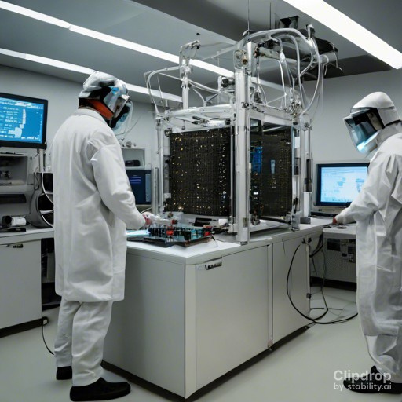
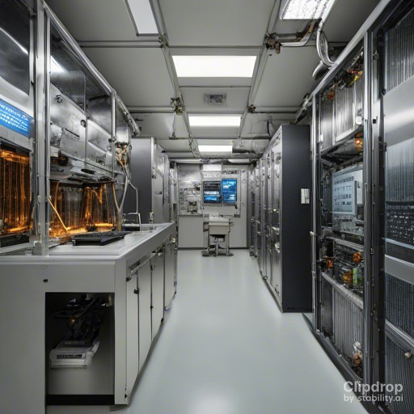
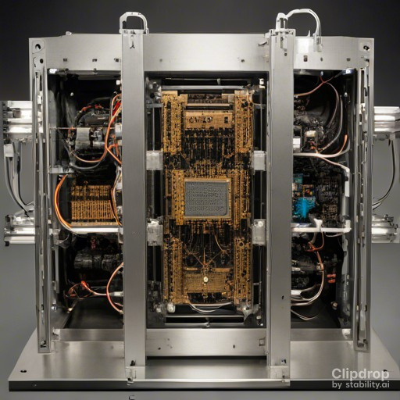
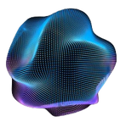





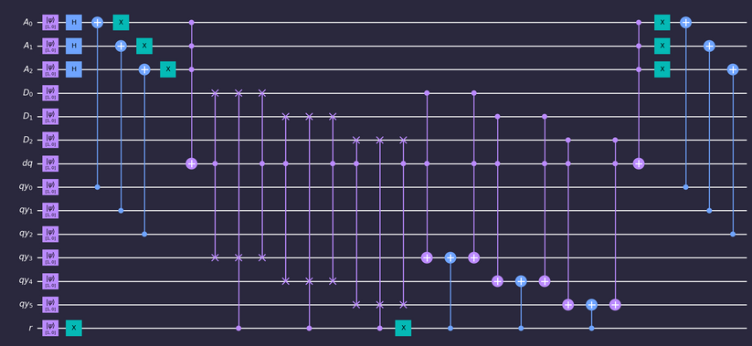
Quantum RAM
Computer Organization and Architecture
|v⟩ Victor Nisem |i⟩ Ismail Sherif |m⟩ Merna Atef |m⟩ Mina Hany Hanna
ABSTRACT
ANALYSIS
METHODOLOGY
CONCLUSION
This Quantum RAM (QRAM) project navigates the world of quantum data storage, demystifying complex concepts with clarity. We unravel QRAM algorithms, sharing a practical side with Python and Qiskit. A focus on efficiency includes a mathematical dive into performance analysis, spotlighting the pivotal role of quantum gates. From theory to application, this project offers a digestible yet profound journey through quantum memory. Join us in deciphering the essentials of data storage in the quantum era, where simplicity meets professionalism in a concise exploration.
In the described quantum algorithm, the process unfolds through six steps to efficiently manage reading and writing operations in a proposed Quantum Random Access Memory (QRAM) model.
Step 1: The algorithm initiates with the application of n Hadamard gates, each acting on a single qubit in the register |Ai. This creates a comprehensive superposition of states in |Ai, providing a basis to address 2n locations in the QRAM.
Step 2: As the address is loaded into the initial n qubits of the bus register |qyi, the QRAM searches for the corresponding location among 2n addresses in |Ai. This involves a sequence of n CNOT gates and n quantum-NOT gates, transforming the target location in |Ai⟩ to the state |11...1⟩ within the superposition.
Step 3: Utilizing a Toffoli gate, the algorithm marks the address matching the input in |qyi⟩ by entangling |dqi with the QRAM. The Toffoli gate's definition involves a logical operation based on the addresses in |Ai⟩.
Step 4: Depending on the state of qubit |ri⟩, loaded by the quantum processor, either a reading or writing process is initiated. For |ri⟩ = 1, the value is copied to the last m qubits of |qyi. Conversely, for |ri⟩ = 0, a controlled-controlled-swap gate is applied for writing, transferring the value from the last n qubits of |qyi to the specified QRAM location.
Steps 5 & 6: These steps involve disentangling qubit |dqi from |Ai using a Toffoli gate and reversing the effects of Step 1 through a sequence of n CNOT and quantum-NOT gates.
This algorithm ensures efficient quantum data storage and retrieval within the QRAM model, employing a combination of quantum gates and controlled operations for optimal performance.
1) Register Preparation:
Initialize quantum registers in a specific state denoted as |ψ0⟩.
The state is a combination of different components:
Hadamard transform (H) applied to the first register |A⟩.
Identity operations (I) applied to auxiliary registers (|D⟩, |dq⟩, |qy⟩).
Vacuum state initialization for all registers.
2) Apply Quantum NOT Gates:
Apply Quantum NOT (X) gates to each qubit in the first register based on the state of the auxiliary qubits (|qy⟩).
This operation is denoted as QNOTAiC, where each qubit in |A⟩ is flipped if the corresponding qubit in |qy⟩ is in the state 1.
3) Quantum Toffoli Gate Operation:
Apply a Toffoli gate (denoted as T) to all qubits in the registers, controlled by the bits in the first register |A⟩.
The Toffoli gate is a quantum gate that performs a NOT operation on the target qubit if both control qubits are in the state 1.
4) Controlled Operations and SWAP:
Perform controlled operations based on certain conditions, involving swapping qubits between registers.
Utilize controlled operations (C) and swap operations (SWAP) to modify the state of the quantum registers.
5) Repeat Toffoli Gate Operation:
Repeat the Toffoli gate operation on the modified state obtained in step 4.
6) Apply Quantum NOT Gates Again:
Apply Quantum NOT (X) gates to each qubit in the first register again, similar to step 2.
the previous experiment proposed a QRAM circuit using well known quantum gates which are (NOT, CNOT, Toffoli, and multi-controlled-swap-gate), it can be used to store both quantum and classical data , the model simulation was made using python programming language in addition to qiskit library , The code defines a Quantum Random Access Memory (QRAM) circuit using Qiskit. Key steps include initializing quantum registers, applying Hadamard gates to address qubits, performing controlled operations, and utilizing various quantum gates such as CX (controlled-X), MCT (multi-controlled Toffoli), and CCX (controlled-controlled-X) to manipulate quantum states for efficient data storage and retrieval. The resulting circuit is then visualized using Matplotlib with specified color styling for clarity.
INTRODUCTION
Informed by the paper "A Novel Efficient Quantum Random Access Memory," our project navigates quantum computing, honing in on Quantum Random Access Memory (QRAM). Leveraging the Toffoli gate from the paper, we present a Python model adept at encapsulating QRAM intricacies, enabling dynamic address marking in the quantum register. Merging theory and practice, our project employs quantum gates to bridge the gap between abstract concepts and real-world application. The Python framework, a practical guide for researchers, demystifies quantum algorithms while serving as a hands-on tool for exploring quantum data storage. Embark on this journey to unravel QRAM's potential in the dynamic landscape of quantum computing.
REFERENCE
https://www.ibm.com/topics/quantum-computing
https://builtin.com/hardware/quantum-computing
COMPONENTS
Registers: Address Register |Ai⟩ uniquely identifies locations, Data Register |Di⟩ stores information. Quantum Bus: Quantum Bus Register |qyi⟩ carries address and data, linking the processor and QRAM. Control Mechanism: Control Qubit |ri⟩ discerns between reading and writing operations. Auxiliary Qubit: An additional qubit |dqi⟩ aids in the writing process.
Quantum Gates: Employed gates include Hadamard, NOT, CNOT, Toffoli, and controlled-controlled-swap.
Fixed Structure: QRAM's fixed architecture enhances efficiency and accessibility. Entanglement: During writing, entanglement between the memory cell and address occurs. Versatility: Enables storage and retrieval of both classical and quantum data.
Advantages: Faster access times (O(1)) and increased storage capacity compared to classical RAMs and existing QRAMs.

Slide 2

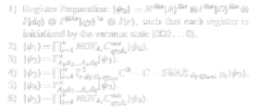
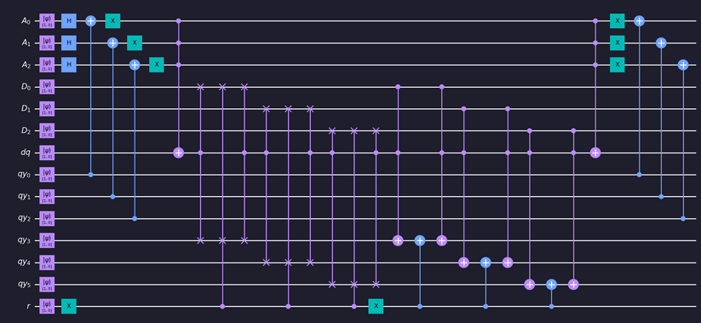
Quantum RAM
Computer Organization and Architecture
|v⟩ Victor Nisem |i⟩ Ismail Sherif |m⟩ Merna Atef |m⟩ Mina Hany Hanna
ABSTRACT
ANALYSIS
METHODOLOGY
6) Apply Quantum NOT Gates Again:
Apply Quantum NOT (X) gates to each qubit in the first register again, similar to step 2.
This Quantum RAM (QRAM) project navigates the world of quantum data storage, demystifying complex concepts with clarity. We unravel QRAM algorithms, sharing a practical side with Python and Qiskit. A focus on efficiency includes a mathematical dive into performance analysis, spotlighting the pivotal role of quantum gates. From theory to application, this project offers a digestible yet profound journey through quantum memory. Join us in deciphering the essentials of data storage in the quantum era, where simplicity meets professionalism in a concise exploration.
In the described quantum algorithm, the process unfolds through six steps to efficiently manage reading and writing operations in a proposed Quantum Random Access Memory (QRAM) model.
Step 1: The algorithm initiates with the application of n Hadamard gates, each acting on a single qubit in the register |A⟩. This creates a comprehensive superposition of states in |A⟩, providing a basis to address 2n locations in the QRAM.
Step 2: As the address is loaded into the initial n qubits of the bus register |qy⟩, the QRAM searches for the corresponding location among 2n addresses in |A⟩. This involves a sequence of n CNOT gates and n quantum-NOT gates, transforming the target location in |A⟩ to the state |11...1⟩ within the superposition.
Step 3: Utilizing a Toffoli gate, the algorithm marks the address matching the input in |qy⟩ by entangling |dq⟩ with the QRAM. The Toffoli gate's definition involves a logical operation based on the addresses in |A⟩.
Step 4: Depending on the state of qubit |r⟩, loaded by the quantum processor, either a reading or writing process is initiated. For |r⟩ = 1, the value is copied to the last m qubits of |qy⟩. Conversely, for |r⟩ = 0, a controlled-controlled-swap gate is applied for writing, transferring the value from the last n qubits of |qy⟩ to the specified QRAM location.
Steps 5 & 6: These steps involve disentangling qubit |dq⟩ from |A⟩ using a Toffoli gate and reversing the effects of Step 1 through a sequence of n CNOT and quantum-NOT gates.
This algorithm ensures efficient quantum data storage and retrieval within the QRAM model, employing a combination of quantum gates and controlled operations for optimal performance.
1) Register Preparation:
Initialize quantum registers in a specific state denoted as |ψ0⟩.
The state is a combination of different components:
Hadamard transform (H) applied to the first register |A⟩.
Identity operations (I) applied to auxiliary registers (|D⟩, |dq⟩, |qy⟩).
Vacuum state initialization for all registers.
2) Apply Quantum NOT Gates:
Apply Quantum NOT (X) gates to each qubit in the first register based on the state of the auxiliary qubits (|qy⟩).
This operation is denoted as QNOTAiC, where each qubit in |A⟩ is flipped if the corresponding qubit in |qy⟩ is in the state 1.
3) Quantum Toffoli Gate Operation:
Apply a Toffoli gate (denoted as T) to all qubits in the registers, controlled by the bits in the first register |A⟩.
The Toffoli gate is a quantum gate that performs a NOT operation on the target qubit if both control qubits are in the state 1.
4) Controlled Operations and SWAP:
Perform controlled operations based on certain conditions, involving swapping qubits between registers.
Utilize controlled operations (C) and swap operations (SWAP) to modify the state of the quantum registers.
5) Repeat Toffoli Gate Operation:
Repeat the Toffoli gate operation on the modified state obtained in step 4.
INTRODUCTION
Informed by the paper "A Novel Efficient Quantum Random Access Memory," our project navigates quantum computing, honing in on Quantum Random Access Memory (QRAM). Leveraging the Toffoli gate from the paper, we present a Python model adept at encapsulating QRAM intricacies, enabling dynamic address marking in the quantum register. Merging theory and practice, our project employs quantum gates to bridge the gap between abstract concepts and real-world application. The Python framework, a practical guide for researchers, demystifies quantum algorithms while serving as a hands-on tool for exploring quantum data storage. Embark on this journey to unravel QRAM's potential in the dynamic landscape of quantum computing.
CONCLUSION
the previous experiment proposed a QRAM circuit using well known quantum gates which are (NOT, CNOT, Toffoli, and multi-controlled-swap-gate), it can be used to store both quantum and classical data , the model simulation was made using python programming language in addition to qiskit library , The code defines a Quantum Random Access Memory (QRAM) circuit using Qiskit. Key steps include initializing quantum registers, applying Hadamard gates to address qubits, performing controlled operations, and utilizing various quantum gates such as CX (controlled-X), MCT (multi-controlled Toffoli), and CCX (controlled-controlled-X) to manipulate quantum states for efficient data storage and retrieval. The resulting circuit is then visualized using Matplotlib with specified color styling for clarity.
COMPONENTS
Registers: Address Register |A⟩ uniquely identifies locations, Data Register |D⟩ stores information. Quantum Bus: Quantum Bus Register |qy⟩ carries address and data, linking the processor and QRAM. Control Mechanism: Control Qubit |r⟩ discerns between reading and writing operations. Auxiliary Qubit: An additional qubit |dq⟩ aids in the writing process.
Quantum Gates: Employed gates include Hadamard, NOT, CNOT, Toffoli, and controlled-controlled-swap.
Fixed Structure: QRAM's fixed architecture enhances efficiency and accessibility. Entanglement: During writing, entanglement between the memory cell and address occurs. Versatility: Enables storage and retrieval of both classical and quantum data.
Advantages: Faster access times (O(1)) and increased storage capacity compared to classical RAMs and existing QRAMs.
REFERENCE
[1] Zidan, M., Abdel‐Aty, A., Khalil, A., Abdel‐Aty, M., & Eleuch, H. (2021). A novel efficient quantum random access memory. IEEE Access, 9, 151775–151780. https://doi.org/10.1109/access.2021.3119588
[2] What is Quantum Computing? | IBM. (n.d.). https://www.ibm.com/topics/quantum-computing

